Slide 1

Final Project Presentation Presentation Title: Tree Disease Identification System Mobile App (TDIS) Project Presentation Name: Md Shamsul Alam ID: 30085837 MSc Artificial Intelligence (AI) Supervisor Carl Jones Senior Lecturer Computer Games Development Faculty of Computing, Engineering and Science

Slide 2
Introduction
Thinking about Detection App for Farmers.
Common Tree Infections and Their Impact.
Tree disease identification mobile app (TDIS).
Work with google colab.
Work with android studio.

Slide 3
Datasets (New Plant Diseases Dataset) preparation.
Finding data set and collect
Images of tree diseases are taken from a huge dataset.
Data Augmentation: Rescaling and enhancing training data with TensorFlow's ImageDataGenerator
Sorting data into directories for training and validation (train-validation split)

Slide 4
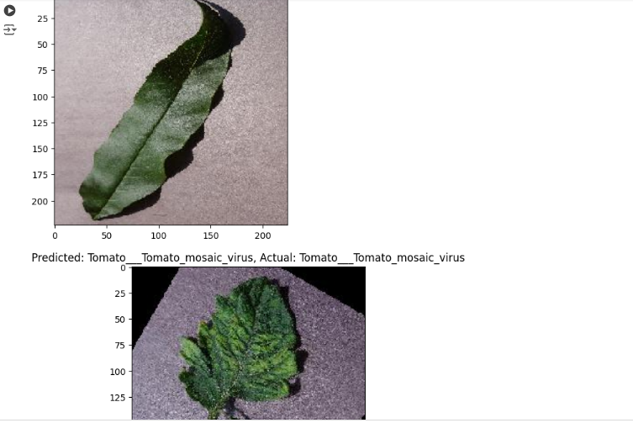
TDIS dataset visualization.
Data Delivery: The dataset is visualized using bar charts and histograms.
Class Classifications: Classification mapping for various tree diseases.
File Numbers: The total count of training and validation photos..

Slide 5
Setup for Feature Extraction Model
TensorFlow Hub: Importing the model that has already been trained.
Untrainable Layers: In order to concentrate on training the last dense layers, feature extractor layers are frozen.
Softmax is used in the output layer to classify several classes.

Slide 6
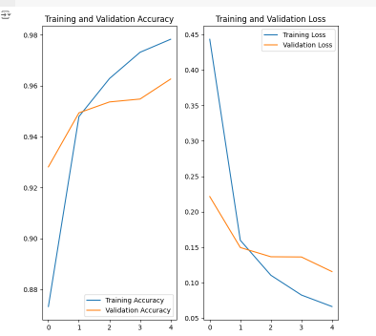
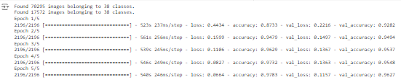
Model Arrangement and Process
Loss Function: For multi-class classification, the loss function is categorical cross-entropy.
Optimizer: Adam optimizer that modifies learning rate precision by using particular epsilon values.
Epochs: Here is model trained for 5 epochs in this code.
Steps per Epoch: The batch size and the number of image.
Valid Steps: here showing calculated for valid data.

Slide 7
Step by Steps Convert the Model on Android apk:
Firstly Convert TensorFlow Model to TensorFlow Lite (TFLite)
Add TensorFlow Lite support to Android Studio
TFLite Model Integration for TDIS Android Apps
Load the TFLite model.
Get Input Data Ready
Utilize the Model Handle Predictions feature in the app to make predictions.

Slide 8
Features of My TDIS App Tools I Use
Camera Integration
Offline Mode
User Interface
Features of My TDIS App Tools I Use
Android Studio
TensorFlow Lite
Java
XML

Slide 9
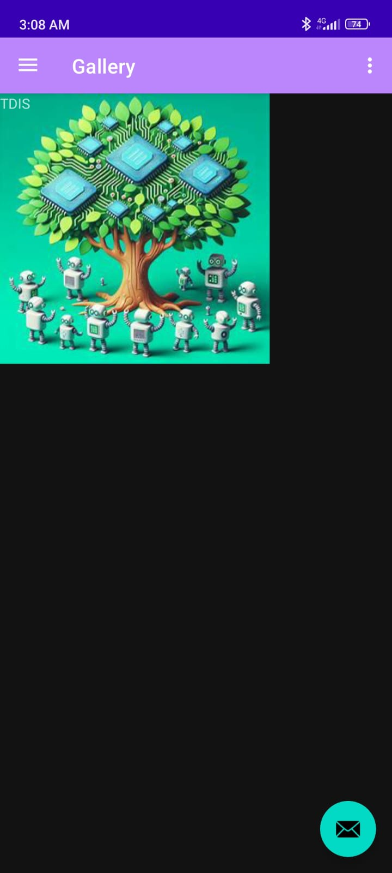
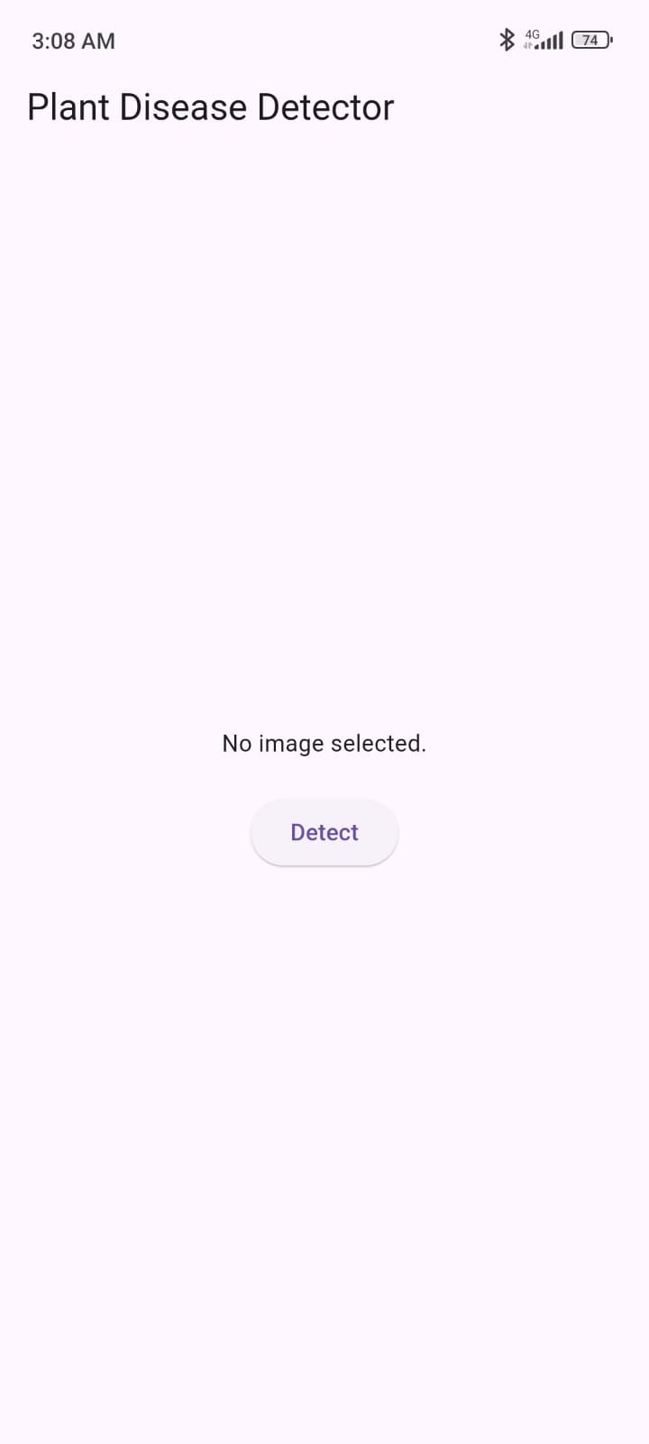
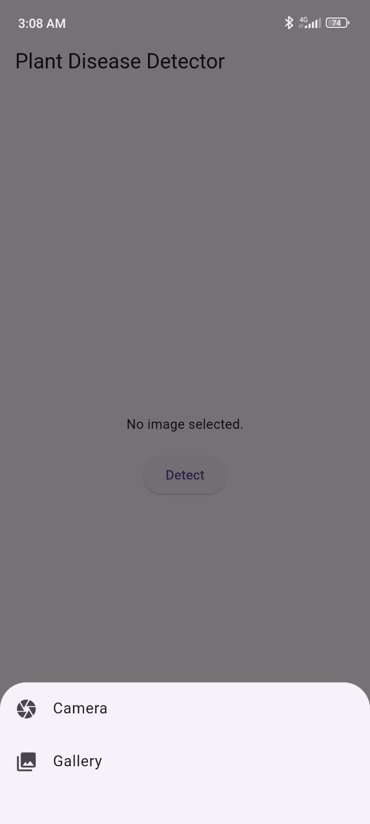
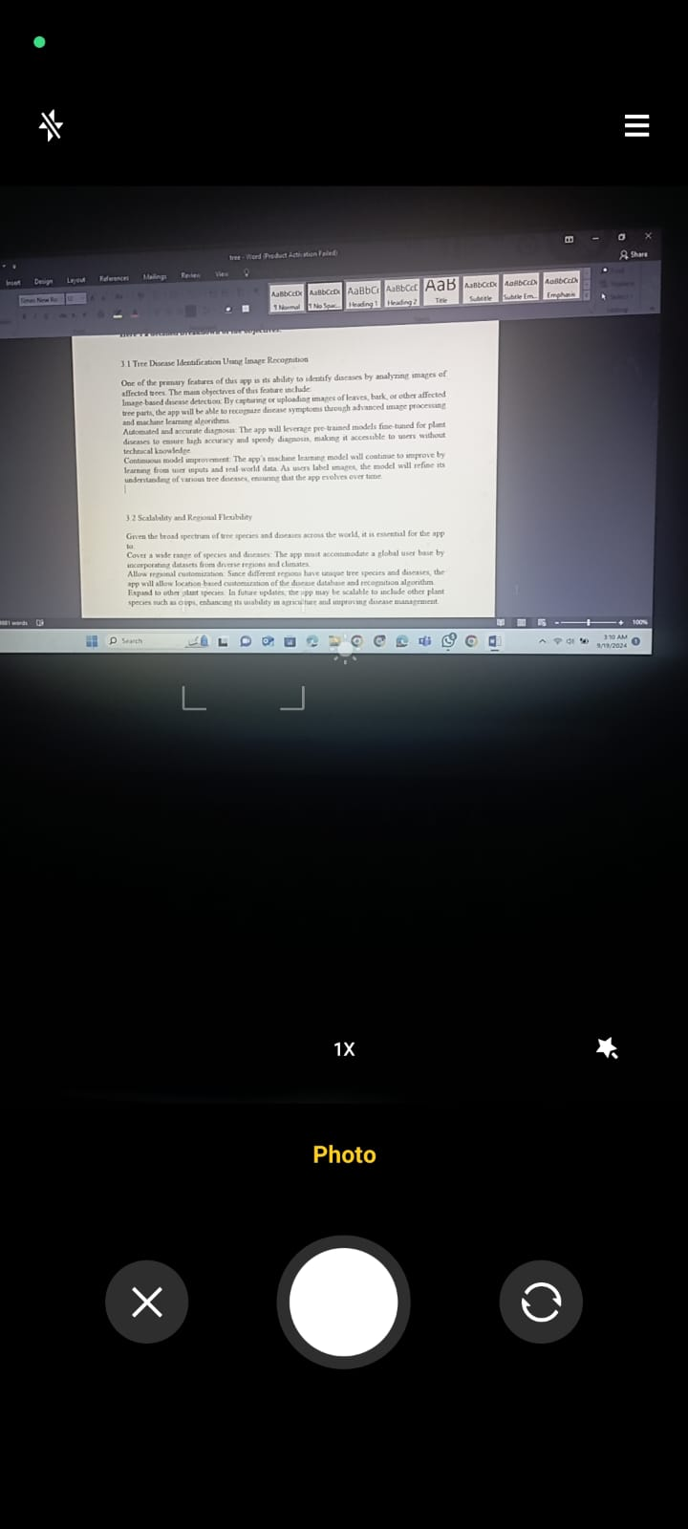
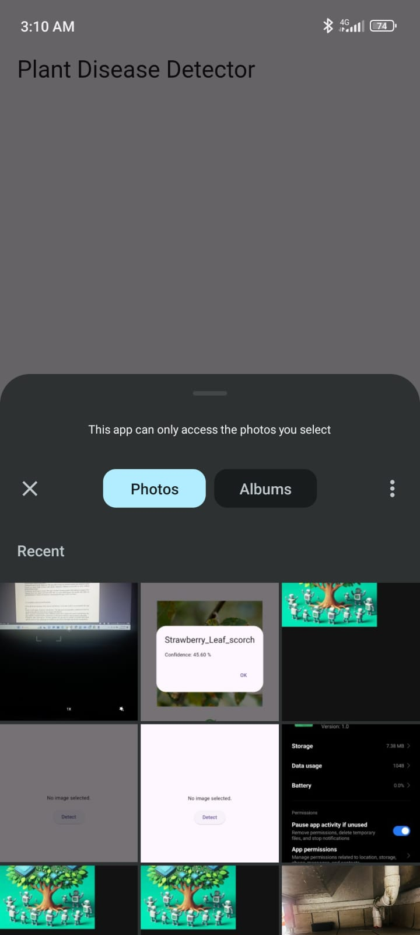
Some Pictures

Slide 10
Thank you

